Slide 1
Water Resources

Slide 2
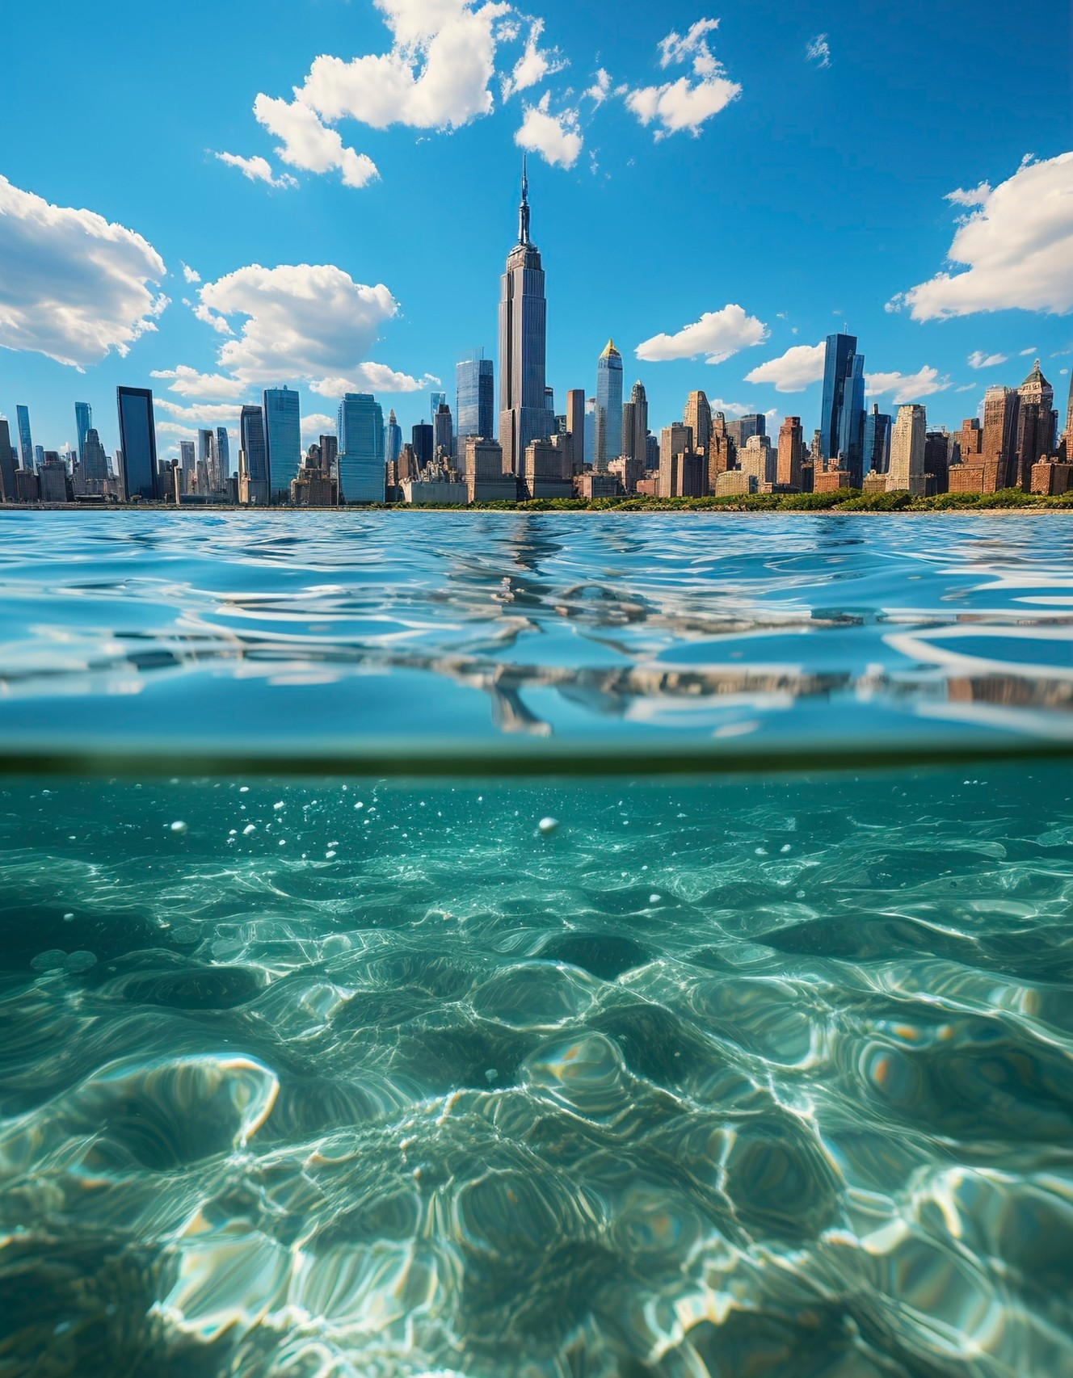
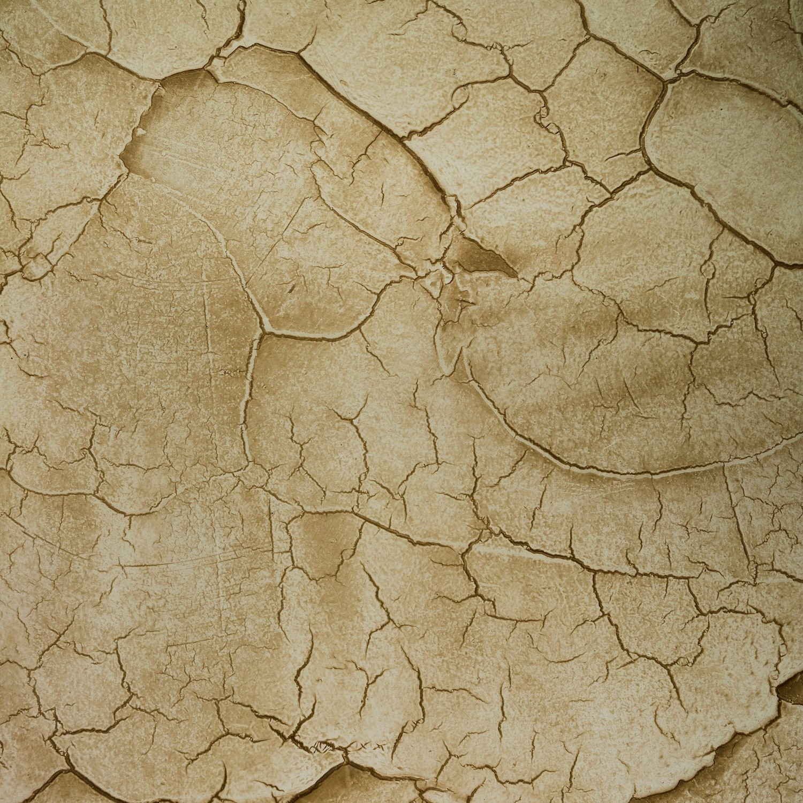
Global Water Crisis
Around 2 billion people lack access to safe drinking water. The global water crisis is exacerbated by climate change, pollution, and over-extraction. Addressing these challenges is vital for the health of our planet and its inhabitants.

Slide 3






Water is vital for , , and . It supports
and is a key factor in . Understanding its sources helps us manage water resources effectively and ensure that future generations have access to this precious resource.

Slide 4
Water Resources
Definition:
Water resources refer to the sources of water that are useful or potentially useful for various human activities, including drinking, agriculture, industry, and energy production. Water is a critical natural resource essential for sustaining life, supporting ecosystems, and driving economic development. Understanding water resources involves studying their types, distribution, uses, challenges, and management practices.

Slide 5
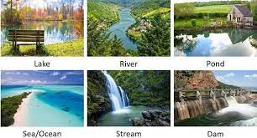
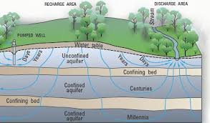
Types of Water Resources
Surface water Ground Water

Slide 6
Surface water
Surface water includes all water that is found on the surface of the Earth in various forms, such as rivers, lakes, reservoirs, wetlands, and oceans.
Rivers and Streams: Rivers are large natural watercourses flowing towards oceans, seas, or other rivers, while streams are smaller bodies of flowing water. Rivers are vital for providing freshwater for drinking, agriculture, and industrial uses. They also play a key role in ecosystems, supporting a diverse range of plant and animal life.
Lakes and Ponds: Lakes are large bodies of standing water surrounded by land, while ponds are smaller, shallower bodies of standing water. Lakes are important for water storage, recreation, and as habitats for fish and wildlife.

Slide 7
Surface water
Reservoirs: Reservoirs are artificial lakes created by damming rivers. They are designed to store water for various purposes, including drinking water supply, irrigation, hydroelectric power generation, and flood control.
Wetlands: Wetlands are areas where water covers the soil or is present at or near the surface of the soil, either seasonally or permanently. Wetlands include marshes, swamps, and bogs. They play a crucial role in filtering water, supporting biodiversity, and regulating water flow.
Oceans and Seas: Oceans and seas contain saline water and cover about 71% of the Earth's surface. While they are not a direct source of freshwater, they are vital for climate regulation, supporting marine ecosystems, and providing food and transportation. Desalination processes can convert seawater into potable water, making oceans an important potential source of freshwater.

Slide 8
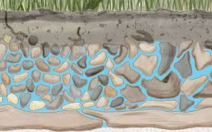
Groundwater
Groundwater is the water found beneath the Earth's surface, stored in the pores and fractures of soil, sand, and rocks. It is a crucial source of freshwater, especially in regions where surface water is scarce.
Aquifers: Aquifers are underground layers of water-bearing rock or sediment that store groundwater. They can be classified into two types:

Slide 9
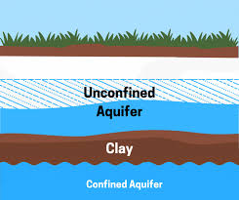
Types of Aquifers
  Unconfined Aquifers: These are aquifers where water seeps from the ground surface directly above the aquifer. They are recharged by precipitation and surface water infiltration.
  Confined Aquifers: These are aquifers that are sandwiched between layers of impermeable rock or clay, which restricts water flow into and out of the aquifer. Confined aquifers are recharged more slowly and often contain older water.

Slide 10
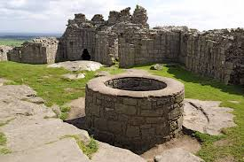
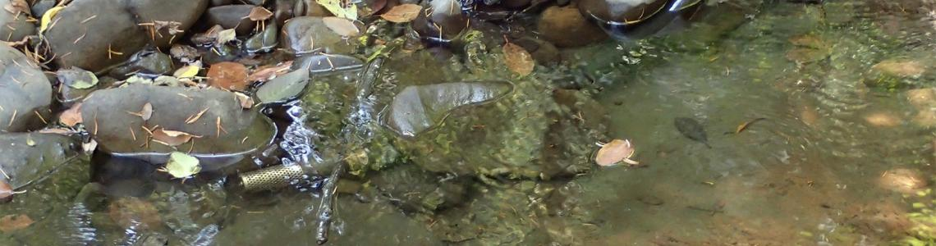
Groundwater
Wells: Wells are man-made structures drilled into aquifers to access groundwater for drinking, irrigation, and industrial use. Wells can be shallow (drawing water from unconfined aquifers) or deep (drawing water from confined aquifers).
Springs: Springs occur where groundwater naturally flows to the Earth's surface, often forming small streams or ponds. They are important sources of freshwater, particularly in hilly or mountainous areas.

Slide 11
Uses of Water Resources
Water resources are essential for various human activities and ecological functions, including:
Drinking Water Supply: Access to clean and safe drinking water is a fundamental human need. Surface water (rivers, lakes, reservoirs) and groundwater (wells, springs) are the primary sources of drinking water. Ensuring water quality through treatment and proper sanitation is critical for public health.
Agriculture: Agriculture is the largest consumer of water resources globally, accounting for about 70% of all water withdrawals. Water is used for irrigation, livestock, and aquaculture. Efficient water use in agriculture is vital for food security and sustainability.

Slide 12
Uses of Water Resources
Industry: Water is essential for various industrial processes, including manufacturing, cooling, and cleaning. Industries such as textiles, paper, chemicals, and food processing are particularly water-intensive. Industrial water use requires careful management to minimize waste and pollution.
Energy Production: Water resources are crucial for energy production, particularly in hydroelectric power generation, which harnesses the kinetic energy of flowing water to generate electricity. Water is also used for cooling in thermal power plants and as a medium in geothermal energy production.

Slide 13
Uses of Water Resources
Ecosystem Support: Water bodies, such as rivers, lakes, and wetlands, provide habitats for diverse plant and animal species. Healthy aquatic ecosystems are essential for maintaining biodiversity, regulating water quality, and supporting fisheries.
Recreation and Tourism: Water resources support recreational activities such as swimming, boating, fishing, and tourism. Lakes, rivers, and coastal areas are popular destinations for leisure and contribute to the local economy.

Slide 14
Challenges in Water Resource Management
Managing water resources effectively is crucial to address the challenges posed by population growth, climate change, pollution, and competing demands.
Water Scarcity: Water scarcity occurs when the demand for water exceeds the available supply. Water scarcity affects agriculture, industry, and domestic water supply, leading to economic and social impacts.
Pollution: Water pollution from agricultural runoff, industrial discharge, and untreated sewage contaminates water bodies, making them unsafe for human use and harming aquatic life. Pollution can lead to the depletion of oxygen in water bodies (eutrophication), the spread of waterborne diseases, and the loss of biodiversity.

Slide 15
Challenges in Water Resource Management
Climate Change: Climate change affects water resources by altering precipitation patterns, increasing the frequency and intensity of extreme weather events (such as floods and droughts), and impacting the availability of freshwater.
Over-extraction of Groundwater: Excessive extraction of groundwater, particularly for irrigation, can lead to the depletion of aquifers, land subsidence, and the intrusion of saline water into freshwater aquifers (saltwater intrusion). This can result in long-term damage to water resources and ecosystems.

Slide 16
Challenges in Water Resource Management
Infrastructure Challenges: Aging or inadequate water infrastructure, such as dams, reservoirs, pipelines, and treatment plants, can lead to water losses, inefficiencies, and the inability to meet growing demand. Investment in modern and resilient infrastructure is essential for ensuring reliable water supply and distribution.

Slide 17


Conclusion: Protecting Our Water
In conclusion, understanding and protecting diverse water sources is essential for sustaining life on Earth. By valuing these , we can ensure that future generations have access to clean water. Let us commit to responsible stewardship of our water resources.

Slide 18
Thanks!

